Slide 1
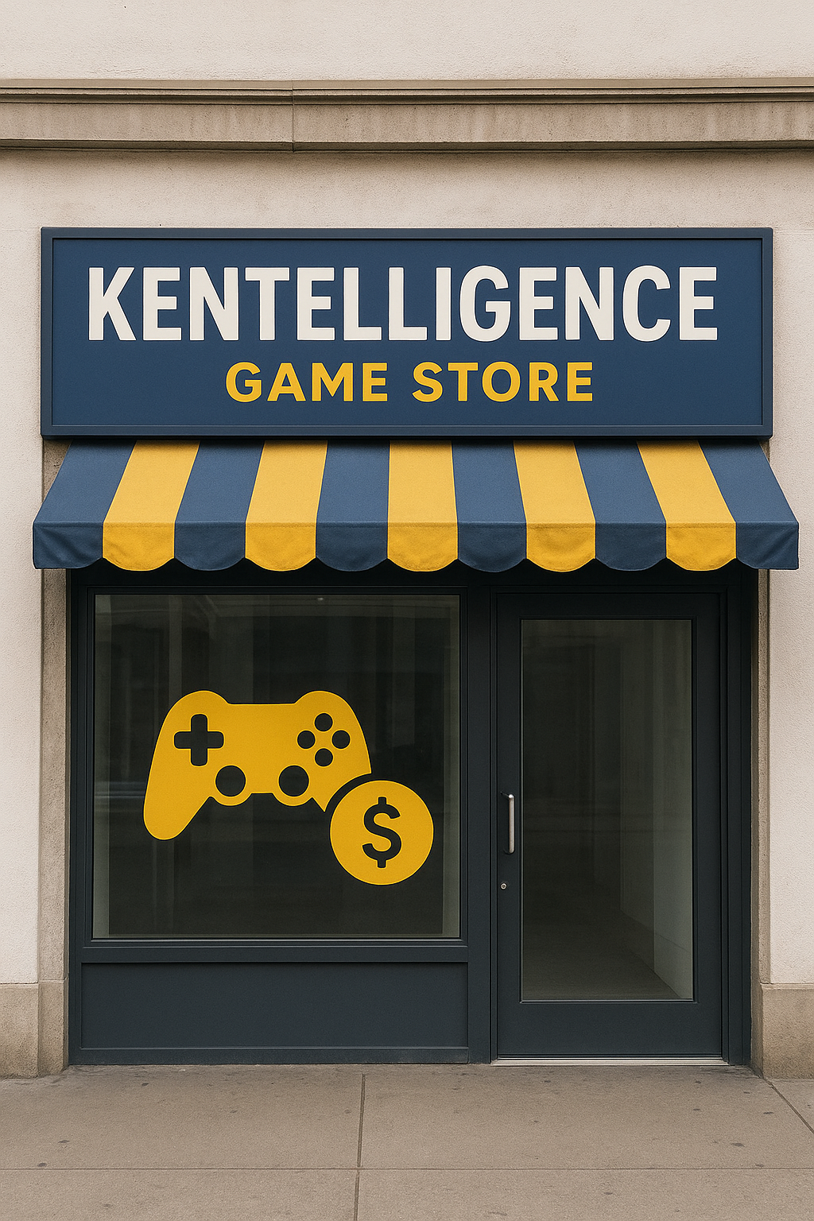
Project Proposal
By Winson, Aryan, Mervyn, Kennard

Slide 2
BACKGROUND:
Background: There is this company that is called Kentelligence games store, located in Ang Mo Kio Industrial Park 2. The company holds values like ensuring the customer leaves the store satisfied, the customer is always right, serving customers with a smile.
This company was founded in 2012, It mainly sells console game CDs, including some video game related merchandise and funko pops.

Slide 3

Problem statement:
Kentelligence game store had their reputation tarnished after a scamming allegation, which cause the company to drop in sales, and also to get lesser conversion rate by the influx of people that heard about the allegation, which also overshadowed the positive aspects of the company.

Slide 4

SOLUTION:
CREATE A GAME
the solution to making a comeback is to attract people back into their company by making a type of program/game that give a certain amount of discount.
More engagement → Higher rate of buyer per viewer → profit

Slide 5
ROLES:
KENNARD: E-LEARNING WINSON: GAME ARYAN:SURVEY MERVYN:QUIZ

Slide 6


E-learning

Slide 7
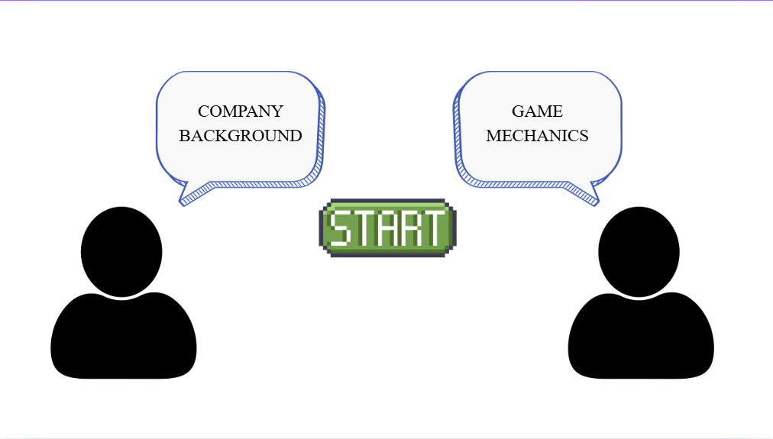
START UP MENU
2 CHARACTERS
EACH CHARACTER SPECIFIC TO THEIR OWN TOPICS THEY'RE GOING TO TEACH
START BUTTON

Slide 8
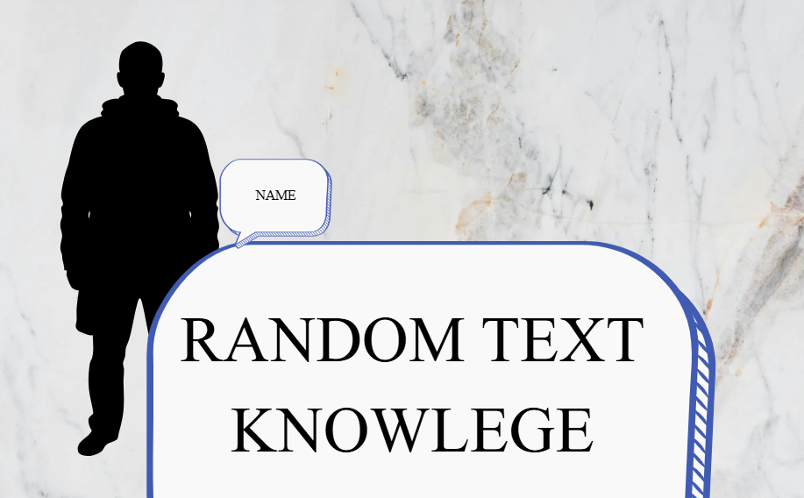

LEARNING STAGE NO.1
FIRST CHARACTER TEACHES COMPANY BACKGROUND.
PERSON ON LEFT TO NOT CONFUSE PEOPLE
CLICK ON SCREEN TO GO NEXT INFO
INCLUDE BACKGROUND SO NOT SO DRY

Slide 9
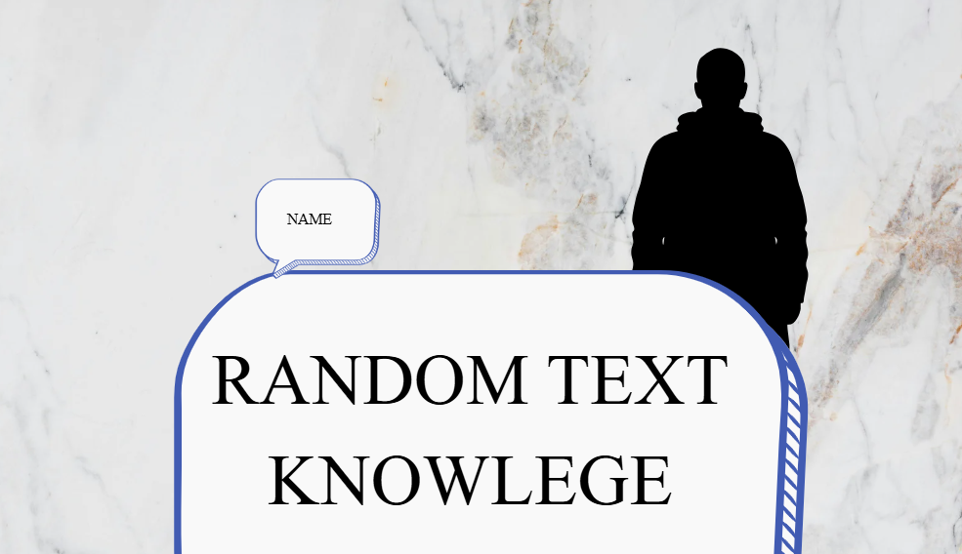
















LEARNING STAGE NO.2
PERSON 2 IS STANDING ON THE RIGHT NOW
PRESS ON SCREEN TO GO NEXT
TEACHES GAME MECHANICS
ADDED BACKGROUND IMAGE
IMAGE OF GAME CONTROLS AND EXPLANATION IN TEXT BOX

Slide 10
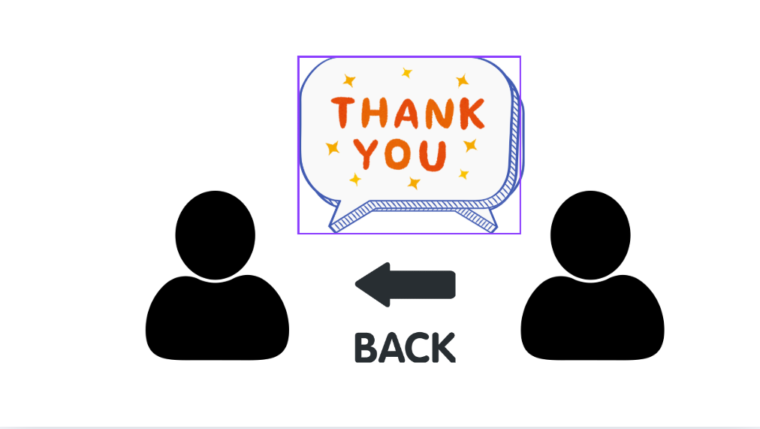
ENDING OF E-LEARNING
BOTH CHARACTERS SAY THANK YOU
BACK BUTTON TO RESTART TO FIRST PAGE
PRESS ON SCREEN TO GO TO QUIZ

Slide 11
HOW WILL IT BENEFIT?
Add engagement to customers and staff
Teach staff,customers,and newer staff on how to play
Efficient, cost-saving
Cheap to implement
High stability(Wont get bored so easily)

Slide 12
Game
It will consist of 3 different mazes and completing each one will give a discount

Slide 13
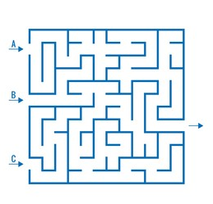
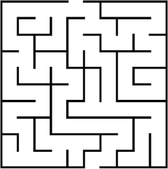
Discount
15% discount
25% discount
50% discount

Slide 14
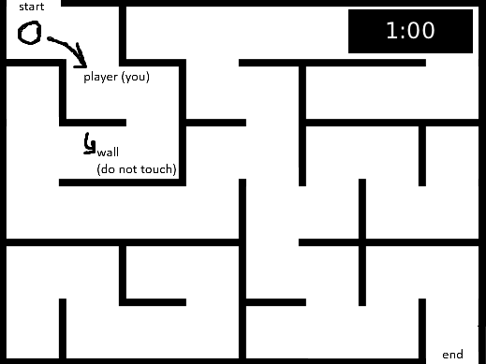
Gameplay - Complete maze within 1 minute - Wall you can't touch

Slide 15
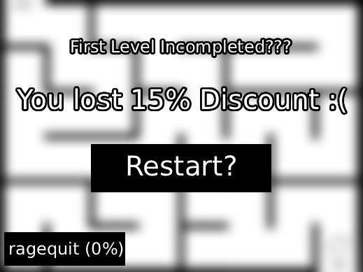
If the player fails: you lose your discount from previous round

Slide 16
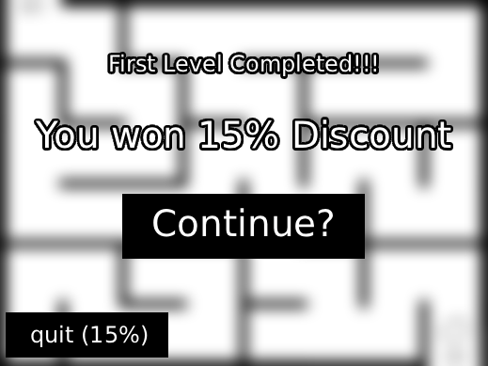
If the player wins: you carry on to next maze to get more discount

Slide 17

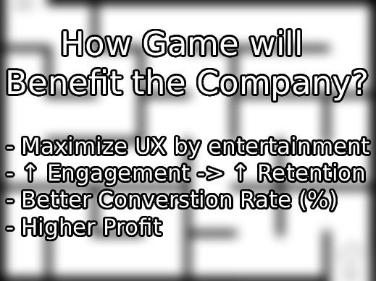

Slide 18

Quiz

Slide 19
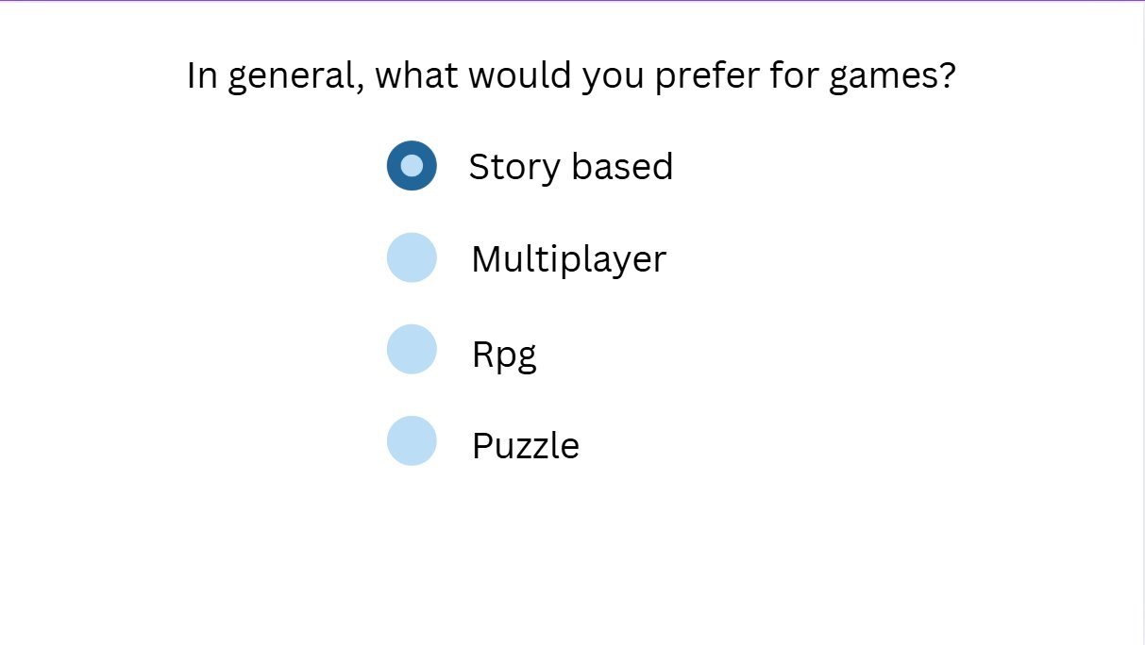
First type of questions
This would be survey based so that by the end of the quiz, the player would be recommended on which game they themselves want.

Slide 20
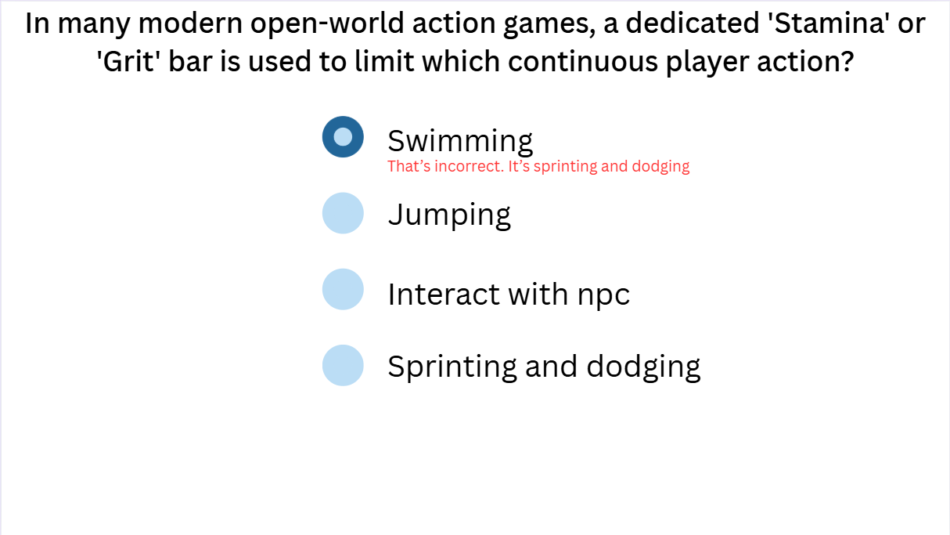
Second type of questions
This would be to test the players knowledge, the reason why we need to do this is so that we can tell how good the player is in general for games. So if the player was new, it can recommend simpler games. However, if it's the opposite it can recommend games with more complicated mechanics.

Slide 21
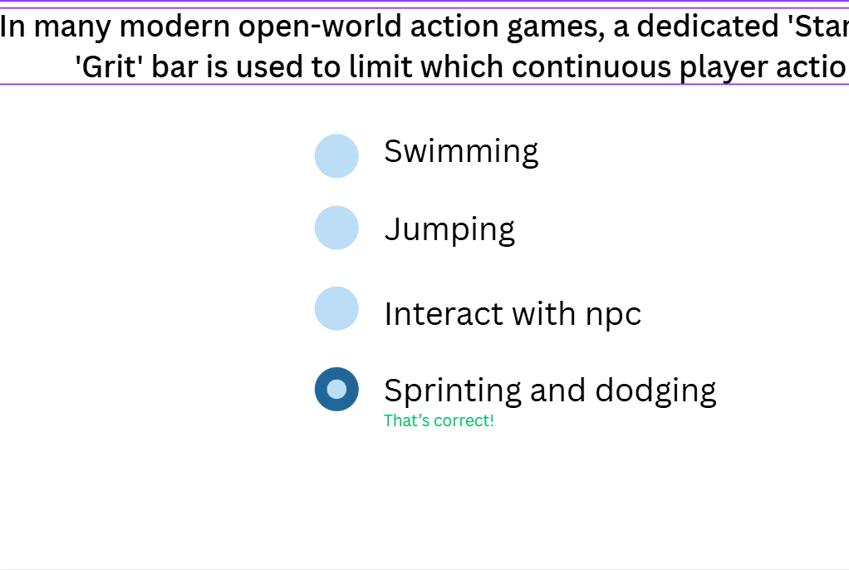
When they get it incorrect or correct

Slide 22

Survey

Slide 23
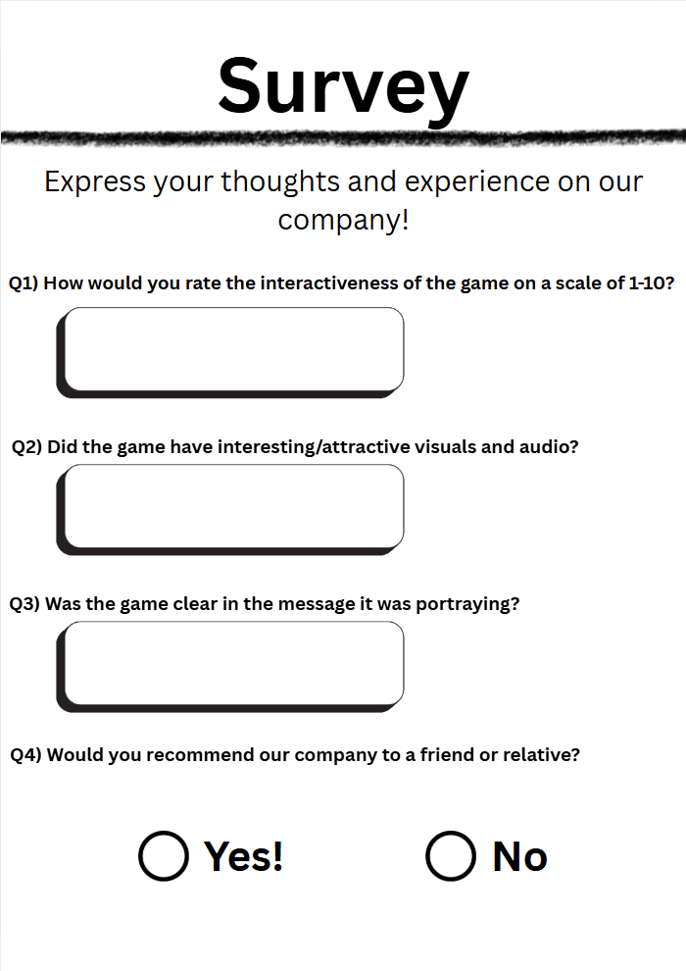
First Page
The first page establishes the purpose of the survey and asks questions regarding the effectiveness of the game in portraying its message, so that the company knows how capturing the game was and how effective it was in its message.

Slide 24
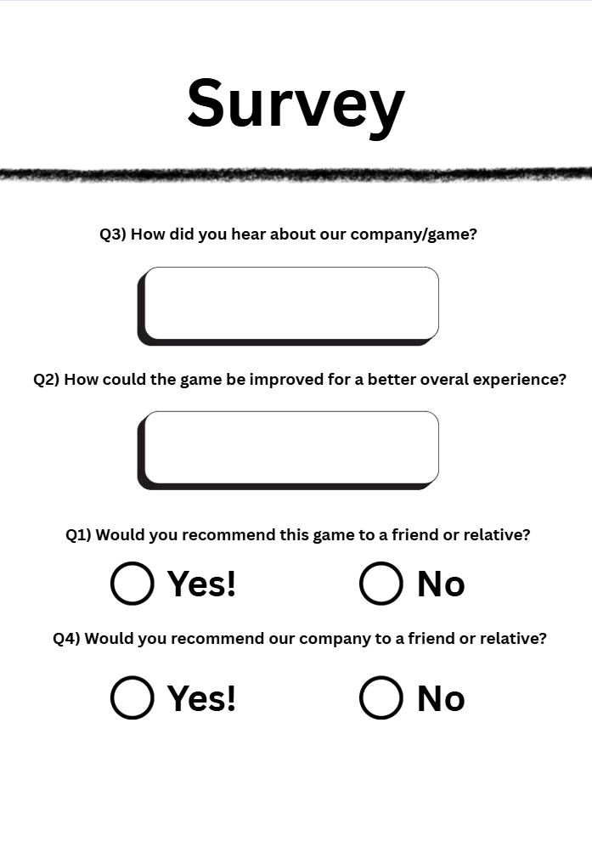
Second Page
The second page aims to tackle the issue of the decrease in the company’s popularity. The questions in this page are designed to not just be normal questions, but questions that may encourage the customers to recommend the game and company to a friend or relative, which would increase the company’s popularity.

